Slide 1
Python Review
Monica Crable

Slide 2
Review:
Objects
Loops
Numpy
Pandas
Exploration
Cleaning
Analysis
Seaborn

Slide 3
Collections of objects
Lists : : An ordered sequence of items. Very common data type in Python. It is very flexible. Uses brackets [ ]. Can store multiple data types.
Dictionary: An unordered collection of key-value pairs. Very similar to json data. It is used when you have a large amount of data. To retrieve the data you must know the key. Multiple values can be assigned to a key by placing them in a list
lst = [‘Cassie’, 3, ‘Rue’, 5, ‘Kat’, 8, ‘Jules’, 10, ‘Maddy’, 12]
Dict = {‘English’: [78,85,99], ‘Math’: [98,76,85]}
Notes:
Objects in python: strings, integers, floats

Slide 4
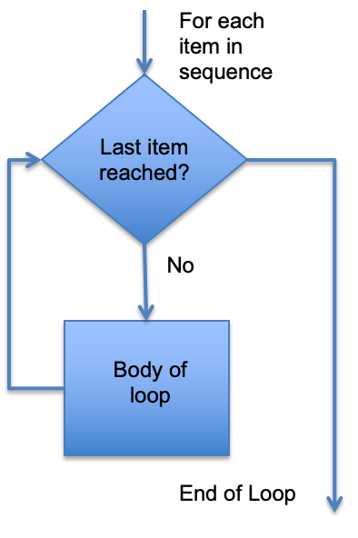
For loops
A for-loop iterates through a collection or sequence of objects and executes a statement for each object.
For i in list:
statement(s)
For i in range(x):
statement(s)
Be sure to indent after each colon.

Slide 5
If-Else, Control Flow
IF-else are used for conditional executions and to control the workflow process
They begin with if, a condition, a colon, and then your execution statements. Multiple conditions will be followed by elif. Else is what you want program to do when all the above conditions are false.
You can add multiple conditions using OR, AND, NOT
If *condition*:
statement(s)
Elif *condition*:
statements(s)
Else:
statements(s)

Slide 6
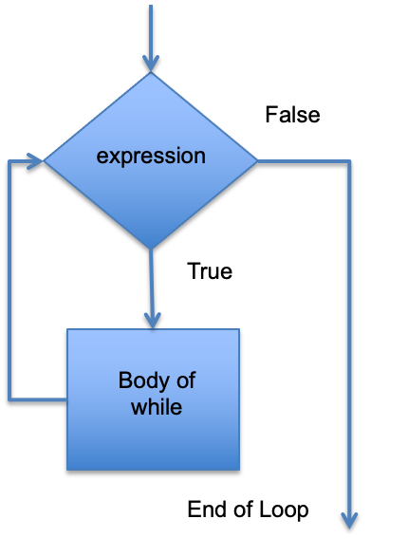
While Loops
While loops repeat a statement or group of statements while a given condition is true. The loop repeats until the condition is false.
While *condition*:
*statement*
*increment*
While x < 10:
print(x)
x=x+1

Slide 7
Conditions
Equal to
a==b
Not Equal to
a!=b
Less than
a < b
Less than or equal to
a <= b
Greater than
a > b
Greater than or equal to:
a >=b

Slide 8
NumPy
NumPy is a Python library that works with multidimensional array objects
Also contains routines to process the arrays
An array is a grid of values of the same type
It is indexed by a tuple of integers that the size of the array along each axis
Arrays are useful when you have to manipulate only specific data type values

Slide 9
NumPy
Import numpy as np
np.linspace allows you to define how many values you get including the specified min and max value. The max value will be inclusive It infers the stepsize:
np.linspace(start,end, #of steps)
np.arange allows you to define the stepsize and infers the number of steps. The end value is exclusive.
np.arange(start, stop, increment size)
Np.random.normal creates random normal distribution
np.random.normal(mean, standard deviation, size)

Slide 10
Numpy vs Pandas
NumPy
Works with numerical data
Powerful tool is Array
Provides objects for multidimensional arrays
Consumes less memory
Has better performance with 50k or less rows
Indexing is very fast
Pandas
Works with tabular data
Powerful tools are DataFrame and Series
Offers 2 dimensional table objects called DataFrames
Consumes more memory
Has better performance with 500k or more rows
Indexing is very slow

Slide 11
Pandas: Data Analysis Library
Pandas is a data analysis library you can import and use in Python. It has a large amount of functions, methods, and attributes you can use. A method is a function that “belongs to” an object. Most of your methods will be used with a dataframe. In documentation, this will usually be labeled as “df”
Import pandas as pd
Variable = pd.function(...)
df.method(...)

Slide 12
Data Exploration
df = pd.read_csv("path\filename.csv")
df = pd.read_excel(r'Path where the Excel file is stored\File name.xlsx')
df = pd.read_excel(r'Path where the Excel file is stored\File name.xlsx', sheet_name='your Excel sheet name')
Df.head(# ofr rows), Df.tail(# of rows)
Df.info(), df.describe()
Df.dtypes
df.columns
len(df)
df.isnull().sum()
df.duplicated().sum()
df.shape

Slide 13
Data Cleaning
df.dropna()
df.fillna(value)
df.drop_duplicates
df.rename(columns = {‘Old Name’: ‘New Name’...)
df["Col Name"].astype(type)
df['ColumnName'] = df['ColumnnName'].str.replace('Old','New') -- Replaces a string character with something else. Find/Replace

Slide 14
Data Analysis
df.groupby("GroupCol")["AggCol"].agg()
pd.pivot_table(data = the dataframe/table you're using, values = the values your going to aggregate , index = what you want on the rows side, #columns = what you want on the columns side, aggfunc = the aggregrate function you're going to use
Subsetting Data: newdf = df[df[‘Column’ *condition*]]
newdf =df.query("Column *condition*'"); the query function is similar SQL

Slide 15
Data Analysis: Seaborn
Import seaborn as sns
sns.set(rc={'figure.figsize': (*width*,*height*)}) ; declare this once and it will configure your size of all your future graphs
ax = sns.boxplot(x = 'category', y = 'measure', data = df, color = 'color')
corr_dataframe = df[['measure', 'measure', 'measure']].corr()
hm = sns.heatmap(corr_dataframe, annot =True)
sns.pairplot(df, plot_kws = {"color": "color"})
sns.heatmap(pivotTable)
sns.swarmplot(x = 'category', y = 'measure', data = df, color = 'color') ; paired with a boxplot

